Slide 1
http://www.comp.nus.edu.sg/~cs2100/
Recitation-12
Cache
14 April 2025
Aaron Tan

Slide 2
Contents
Cache Revision
Past year’s exam question
AY2021/22 Sem1 Q16
Cache Quiz

Slide 3
AY2021/22 Semester 1 Exam Q16

Slide 4
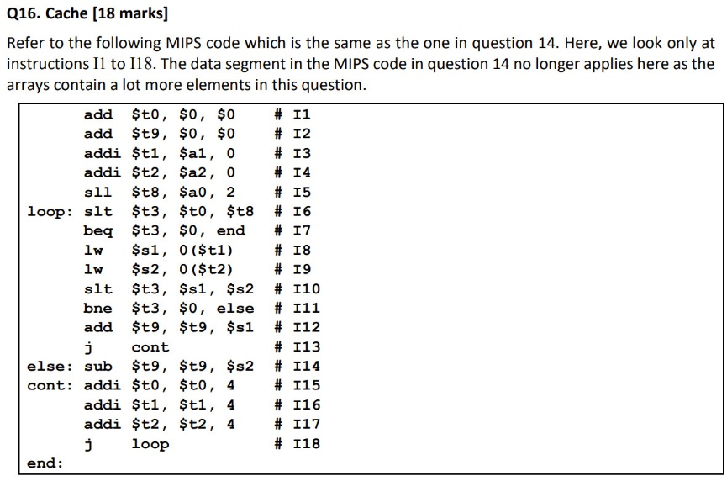
AY2021/22 Sem1 Q16

Slide 5
AY2021/22 Sem1 Q16

