Slide 1
CS2100
Tutorial #5
MIPS Processor:
Datapath and control
(Prepared by: Aaron Tan)

Slide 2
Generating ALUControl Signal
From lecture slide:
Opcode | ALUop | Instruction Operation | Funct field | ALU action | ALU control
lw |  | load word |  | add
sw |  | store word |  | add
beq |  | branch equal |  | subtract
R-type |  | add |  | add
R-type |  | subtract |  | subtract
R-type |  | AND |  | AND
R-type |  | OR |  | OR
R-type |  | set on less than |  | set on less than
Instruction Type | ALUop
lw / sw | 00
beq | 01
R-type | 10
00
xxxxxx
0010
00
xxxxxx
0010
01
xxxxxx
0110
10
10 0000
0010
10
10 0010
0110
10
10 0100
0000
ALUcontrol | Function
0000 | AND
0001 | OR
0010 | add
0110 | subtract
0111 | slt
1100 | NOR
10
10 0101
0001
10
10 1010
0111
Generation of 2-bit ALUop signal will be discussed later

Slide 3
Design of ALU Control Unit (1/2)
From lecture slide:
Input: 6-bit Funct field and 2-bit ALUop
Output: 4-bit ALUcontrol
Find the simplified expressions
ALUcontrol3 = 0
ALUcontrol2 = ?
ALUop0 + ALUop1⋅ F1
 | ALUop |  | Funct Field ( F[5:0] == Inst[5:0] ) |  |  |  |  |  | ALU control
 | MSB | LSB | F5 | F4 | F3 | F2 | F1 | F0
lw
sw
beq
add
sub
and
or
slt
0
0
X
X
X
X
X
X
0 0 1 0
0
0
X
X
X
X
X
X
0 0 1 0
X
0
1
X
X
X
X
X
X
0 1 1 0
1
0
1
0
0
0
0
0
0 0 1 0
X
X
X
1
0
1
0
0
0
1
0
0 1 1 0
X
X
X
1
0
1
0
0
1
0
0
0 0 0 0
X
X
X
1
0
1
0
0
1
0
1
0 0 0 1
X
X
X
1
X
X
X
0
1
0
1
0
1
0
0 1 1 1

Slide 4
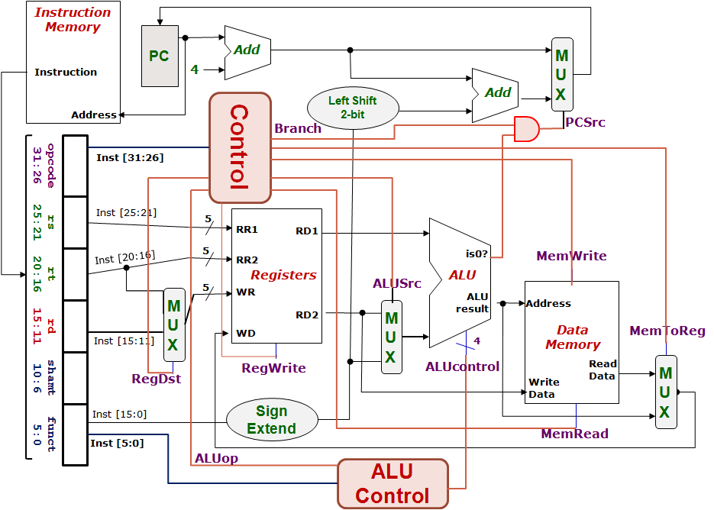
Control Design: Outputs
From lecture slide:
 | RegDst | ALUSrc | MemToReg | Reg Write | Mem Read | Mem Write | Branch | ALUop
 |  |  |  |  |  |  |  | op1 | op0
R-type
lw
sw
beq
1
0
0
1
0
0
0
1
0
0
1
1
1
1
0
0
0
0
X
1
X
0
0
1
0
0
0
X
0
X
0
0
0
1
0
1
0
1
0
1
0
1
1
0

Slide 5
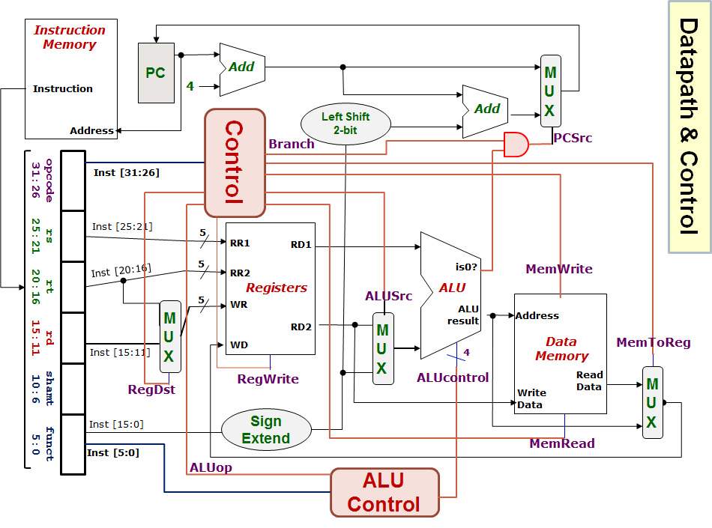
beq $1, $3, 12
If (R[rs]==R[rt]) PC=PC+4+BrAddr
000100 00001 00011 0000000000001100
Registers File |  |  |  | ALU |  | Data Memory
RR1 | RR2 | WR | WD | Opr1 | Opr2 | Address | Write Data
Q1(i)
Red means the data is actually used.
Blue means the data is not used.
$1
$3
$3 or $0
[$1]-[$3] or
MEM([$1]-[$3]) (random)
[$1]
[$3]
[$1] – [$3]
[$3]
0
1
RegDest
RegWrite
ALUSrc
MemRead
MemWrite
MemToReg
Branch
ALUop
ALUcontrol
Easy, just copy from tables in previous slides.
X
0
1
0
000100
0
Next PC value = PC + 4
or (PC+4) + (12×4)
00001
0
Opr1
X
00011
0
0
1
1
00000 00000 001100
0
1
01
Opr2
X
0
0110
1
0
X
0

Slide 6
lw $24, 0($15)
R[rt] = M[R[rs]+SignExtImm]
100011 01111 11000 0000000000000000
Registers File |  |  |  | ALU |  | Data Memory
RR1 | RR2 | WR | WD | Opr1 | Opr2 | Address | Write Data
Q1(ii)
$15
$24
$24
MEM([$15]+0)
[$15]
0
[$15]+0
[$24]
Next PC value = PC + 4
0
1
RegDest
RegWrite
ALUSrc
MemRead
MemWrite
MemToReg
Branch
ALUop
ALUcontrol
0
1
0
1
100011
1
01111
0
Opr1
1
11000
0
0
1
0
00000 00000 000000
0
1
00
Opr2
1
0010
1
0
1

Slide 7
sub $25, $20, $5
R[rd] = R[rs] – R[rt]
000000 10100 00101 11001 00000 100010
Registers File |  |  |  | ALU |  | Data Memory
RR1 | RR2 | WR | WD | Opr1 | Opr2 | Address | Write Data
Q1(iii)
$20
$5
$25
[$20] – [$5]
[$20]
[$5]
[$20] – [$5]
[$5]
0
1
Next PC value = PC + 4
RegDest
RegWrite
ALUSrc
MemRead
MemWrite
MemToReg
Branch
ALUop
ALUcontrol
1
1
0
0
000000
0
10100
0
Opr1
0
00101
0
0
1
0
11001
0
1
10
Opr2
1
0110
00000
1
0
100010
0

Slide 8
Critical Path Analysis
a
b
c
Duration = a + b + c
4
5
Sequence/Series
2
8
a
5
3
6
b
5
c
Critical path duration = 5 + 4 + 8 + 6 = 23
Duration = max(a,b,c)
Parallel

Slide 9
SUB instruction
Inst-Mem (400)
Reg.File (200)
MUX (ALUSrc)
(30)
ALU
(120)
MUX (MToR)
(30)
Reg.File
(200)
Control (100)
Q2(a)
Not critical path
Inst-Mem
400ps
-------------
Adder
100ps
-------------
MUX
30ps
-------------
ALU
120ps
-------------
Reg-File
200ps
-------------
Data-Mem
350ps
-------------
Control/ALUControl
100ps
-------------
Lshft/signext/AND
20ps
400+200+30+120+30+200 = 980ps
0
1
0
1
0
1
0
1
1
0

Slide 10
LW instruction
Inst-Mem (400)
Reg.File (200)
ALU
(120)
DataMem
(350)
MUX (MToR)
(30)
Reg.File
(200)
Control (100)
Q2(b)
Not critical path
Inst-Mem
400ps
-------------
Adder
100ps
-------------
MUX
30ps
-------------
ALU
120ps
-------------
Reg-File
200ps
-------------
Data-Mem
350ps
-------------
Control/ALUControl
100ps
-------------
Lshft/signext/AND
20ps
400+200+120+350+30+200 = 1300ps
0
1
0
1
0
1
1
0
Why is MUX (ALUSrc) not included this time?

Slide 11
BEQ instruction
Inst-Mem (400)
Reg.File (200)
MUX (ALUSrc)
(30)
ALU
(120)
AND
(20)
MUX (PCSrc)
(30)
Control (100)
Q2(c)
Not critical path
Inst-Mem
400ps
-------------
Adder
100ps
-------------
MUX
30ps
-------------
ALU
120ps
-------------
Reg-File
200ps
-------------
Data-Mem
350ps
-------------
Control/ALUControl
100ps
-------------
Lshft/signext/AND
20ps
400+200+30+120+20+30 = 800ps
0
1
How about the green path: PC → Adder → MUX (PCSrc)?
How about the purple path: Inst.Mem → SignExt → LeftShift → Adder → MUX(PCSrc)?
0
1
0
1
1
0

Slide 12
Preliminary ….. for next set of Qs
We will stick to (some) R-type, lw, sw and beq to keep things simple for this tutorial
#include <stdint.h> provides (some) bitwidth datatypes
int8_t, int_16_t, int32_t, int64_t, uint8_t, uint_16_t, uint32_t, and uint64_t for signed 8, 16, 32, and 64 bit integers and unsigned 8, 16, 32, and 64 bit integers, respectively
Otherwise, something like int can be of different bitwidths on different machines and compilers
Use #include <stdbool.h> for Booleans (i.e., 1 bit true/false)
Hardware description languages allow for arbitrary bitwidth (even parametrized ones) to be used
C (from the C11 standard onwards) provides “bit fields” (arbitrary bit widths) but only for structs and unions (See later)

Slide 13
Q3(a) Write a C data structure and a function to describe the register file and its operations.
An array of integers to store the registers content. The index shall be the name (i.e., register number) of the register.
int32_t _rf[32];
void RegFile(uint5_t RR1,
uint5_t RR2,
uint5_t WR,
int32_t WD,
int32_t *RD1,
int32_t *RD2,
bool RegWrite) {
// Because we need to send out multiple outputs,
// we will use passing by pointers.
*RD1 = (RR1 > 0)?_rf[RR1]:0;
*RD2 = (RR2 > 0)?_rf[RR2]:0;
if (RegWrite && WR)
_rf[WR] = WD;
}
Since we need to return two outputs, we will need to pass them back via pointers.
Make sure that register 0 returns 0.
Make sure that we never write to register 0. Actually, harmless coz you can never read the content back. Still, just for completeness.
We can use C’s conditional statement or if-then-else. Both are perfectly fine.

Slide 14
Q3(b) Write a C data structure and a function to describe the data memory and its operations.
Ridiculous number but without introducing OS, we will just live with this for now.
int32_t data_memory[1073741824];
int32_t AccessDataMemory(uint32_t address,int32_t WrData,
bool MemRead, bool MemWrite)
{
// We can do a sanity check here. You can at most do one memory operation.
// Will assume that "error" raises hell.
if (MemRead && MemWrite) {
error("Cannot do both read and write at the same time.")
}
if (MemRead) {
return data_memory[address];
}
if (MemWrite) {
data_memory[address] = WrData;
return 0;
}
}
Simple error checking
Straightforward

Slide 15
Q4. Multiplexing.
Macro processing is kind of automated text processing of your source code before it is passed to the compiler. It is useful especially for shortening repetitive coding. Not just save space but also so that you only need to fix one piece of code instead of fixing all the repeated copies. In the repetition process, it can also allow the programmer to vary some parts of the repetition on a case by case basis.
Macro “MUX” defined with “N” as a parameter.
Token pasting: the token “uint” is pasted with the value of parameter N and then with “_t”
Token pasting: the token “mux” is pasted with the value of parameter N to form a new token
In macro, one line, one statement. If you want to span multiple lines, use “\” for continuation.
#define MUX(N) \
int##N##_t mux##N (int##N##_t in0, \
int##N##_t in1, \
bool ctrl) \
{ \
if (ctrl) return in1; \
else return in0; \
}

Slide 16
Q4. Multiplexing.
Macro processing is kind of automated text processing of your source code before it is passed to the compiler. It is useful especially for shortening repetitive coding. Not just save space but also so that you only need to fix one piece of code instead of fixing all the repeated copies. In the repetition process, it can also allow the programmer to vary some parts of the repetition on a case by case basis.
Example:
MUX(8);
#define MUX(N) \
int##N##_t mux##N (int##N##_t in0, \
int##N##_t in1, \
bool ctrl) \
{ \
if (ctrl) return in1; \
else return in0; \
}
int8_t mux8(int8_t in0,
int8_t in1,
bool ctrl)
{
if (ctrl) return in1;
else return in0;
};

Slide 17
Q5. Main control.
Recall: Control Design – Outputs
 | RegDst | ALUSrc | MemToReg | Reg Write | Mem Read | Mem Write | Branch | ALUop
 |  |  |  |  |  |  |  | op1 | op0
R-type
lw
sw
beq
1
0
0
1
0
0
0
1
0
0
1
1
1
1
0
0
0
0
X
1
X
0
0
1
0
0
0
X
0
X
0
0
0
1
0
1
0
1
0
1
0
1
1
0

Slide 18
Q5. Main control.
 | RegDst | ALUSrc | MemToReg | Reg Write | Mem Read | Mem Write | Branch | ALUop
 |  |  |  |  |  |  |  | op1 | op0
R-type | 1 | 0 | 0 | 1 | 0 | 0 | 0 | 1 | 0
lw | 0 | 1 | 1 | 1 | 1 | 0 | 0 | 0 | 0
sw | X | 1 | X | 0 | 0 | 1 | 0 | 0 | 0
beq | X | 0 | X | 0 | 0 | 0 | 1 | 0 | 1
(a) _RegDst
if (!opcode) *_RegDst = 1;
else *_RegDst = 0;
(b) _ALUSrc
if (!opcode || opcode == 4) *_ALUSrc = 0;
else *_ALUSrc = 1;
(c) _MEMRead
if (opcode == 0x23) *_MemRead = 1;
else *_MemRead = 0;
beq:opcode = 0x4
lw: opcode = 0x23
sw:opcode = 0x2b
(d) _ALUOp
switch (opcode) {
case 0: *_ALUOp = 2;
case 0x23: // lw
case 0x2b: *_ALUOp = 0; // sw
case 0x4: *_ALUOp = 1; // beq
}

Slide 19
Q6. ALUcontrol.
uint4_t ALUControl(uint2_t _ALUOp, uint6_t _funct) {
if (_ALUOp == 2) { // R-type; need to decode funct
switch (_funct) {
case 0x20: return 2; // add
case 0x22: return 6; // sub
case 0x24: return 0; // and
case 0x25: return 1; // or
case 0x27: return 0xC; // nor
case 0x2a: return 7; // slt
default: } // raise an error
}
else { // non R-type
if (_ALUOp == 0)
return 2; // Ask ALU to add
if (_ALUOp == 1)
return 6; // Ask ALU to subtract
}
}
 | ALUop
 | op1 | op0
R-type | 1 | 0
lw | 0 | 0
sw | 0 | 0
beq | 0 | 1
ALUcontrol | Function
0000 | AND
0001 | OR
0010 | add
0110 | subtract
0111 | slt
1100 | NOR

Slide 20
Q7. ALU.
int32_t ALU(int32_t in0, int32_t in1,
uint4_t ALUcontrol, bool *ALUiszero)
{
int32_t result;
switch (ALUcontrol) {
case 0: result = in0 & in1; break;
case 1: result = in0 | in1; break;
case 2: result = in0 + in1; break;
case 6: result = in0 - in1; break;
case 7: result = (int32_t)(in0 < in1); break;
case 12: result = ~(in0 | in1); break;
}
*ALUiszero = (result == 0);
return(result);
}
in1 may be rt or immed. But this is settled prior to invoking the ALU.
ALUcontrol | Function
0000 | AND
0001 | OR
0010 | add
0110 | subtract
0111 | slt
1100 | NOR
Our input parameters are signed, so we are doing signed comparison here.
ALUiszero passed by pointer and is always set based on the result.
We use the bitwise complement (NOT) of C. Cannot use logical NOT “!”

Slide 21
For Fun
Borrowed from the book, “Gulliver’s Travels” by Jonathan Swift
Fundamental disagreement on how to crack open one’s boiled egg – from small end or from the big end ☺
Terms Big-Endian and Little-Endian introduced to Computing by Danny Cohen
Internet Engineering Note (Note 137), “On Holy Wars and a Plea for Peace”: https://www.ietf.org/rfc/ien/ien137.txt
Gulliver’s Travels is available for free as part of Project Gutenberg: https://www.gutenberg.org/ebooks/65473
First time Big-Endian is mentioned is on page 45 in chapter 4

Slide 22
Tutors: A datapath diagram for your use.
0
1
Opr1
0
1
0
1
Opr2
1
0

Slide 23
END OF FILE

