Slide 1
WARNING
These slides are not optimized for printing or exam preparation. These are for lecture delivery only.
These slides are made for PowerPoint 2010. They may not show up well on other PowerPoint versions. You can download PowerPoint 2010 viewer from here.
These slides contain a lot of animations. For optimal results, watch in slideshow mode.

Slide 2
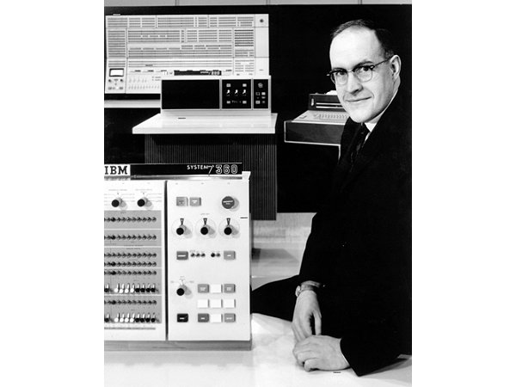

Slide 3
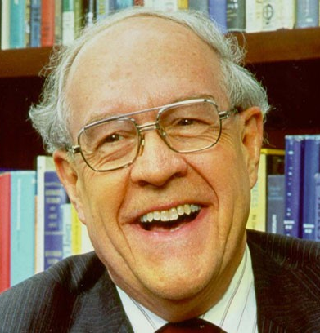
Prof. Fred Brooks, Jr.
Brooks's law : "adding manpower to a late software project makes it later"

Slide 4
Brooks's law : "adding manpower to a late software project makes it later"

Slide 5
Gems of Wisdom:
Software Development Principles.
Brooks's law : "adding manpower to a late software project makes it later"

Slide 6
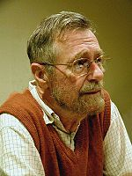
Principle of separation of concerns
SYSTEM
Refresh data storage
Interact with user
Show message to user
Authenticate user
Get user input
Store user data
Encrypt password
by Edsger Dijkstra

Slide 7
Open-closed principle
Software entities should be open for extension, but closed for modification.
Minefield
*
*
MinedCell
EmptyCell
MagicCell
*

Slide 8
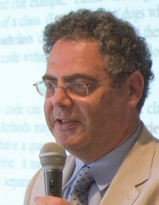
Open-closed principle
Software entities should be open for extension, but closed for modification.
Minefield
*
{abstract} Cell
MinedCell
EmptyCell
MagicCell
by Bertrand Meyer

Slide 9
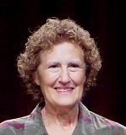
Liskov substitution principle
Subclasses should be substitutable for their base classes.
Minefield
*
{abstract} Cell
MinedCell
EmptyCell
MagicCell
by Barbara Liskov

Slide 10
Single responsibility principle
Every class should have only one reason to change (i.e. should have only one single responsibility).
Similar to Separation of Concerns?
Minefield
{abstract} Cell
Score
Mine
by Robert C. Martin (Uncle Bob)
SOLID Principles

Slide 11
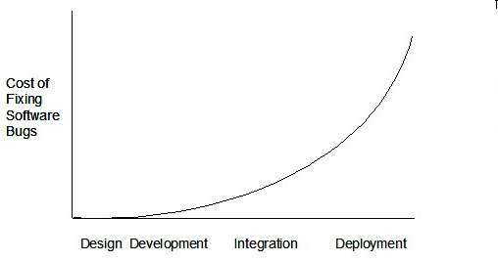
The later you find a bug, the more it costs

Slide 12
[extra] Good, cheap, fast: select any two
Good
Cheap
Fast

Slide 13
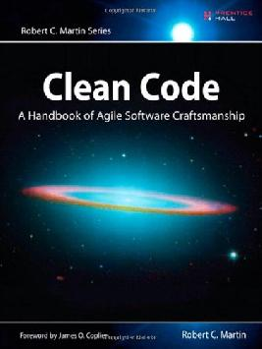

Slide 14
1. Separation of concerns
2. Single responsibility principle
3. Open closed principle 4. ……
Use in the project as much as you can.
At least, be able to relate to the project

